Slide 1
Software QA and Testing with Automation using Selenium IDE Course 1, Class 1 Deck 2 Selenium IDE
Instructor
David F Wagoner
PMP, CSQE, CMQ/OE

Slide 2
Selenium
Selenium is a state-of-the-practice test automation tool used by many web development companies
Includes a macro recorder and very basic library function. This will be used in the section of the course (Part I)
The Selenium Web Driver is the more rigorous automated suite with several programming interfaces (perl, python…etc.). This will be used in Part II of this course. We’ll be using Python.

Slide 3
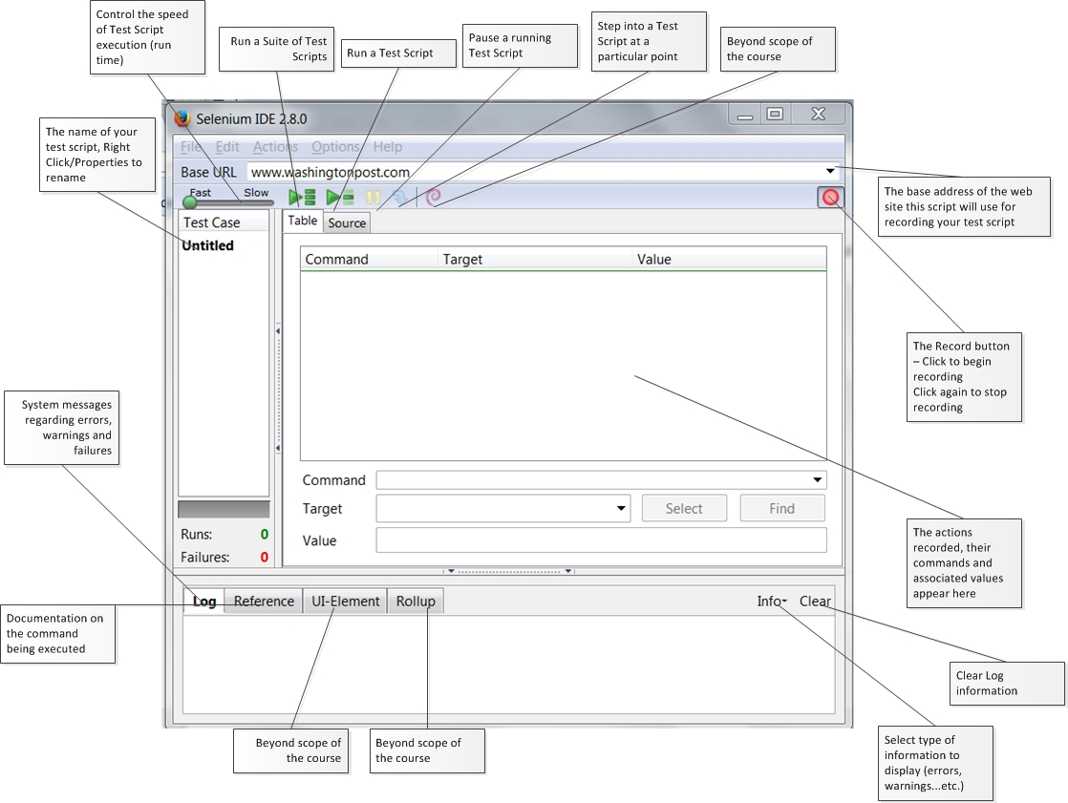

Slide 4
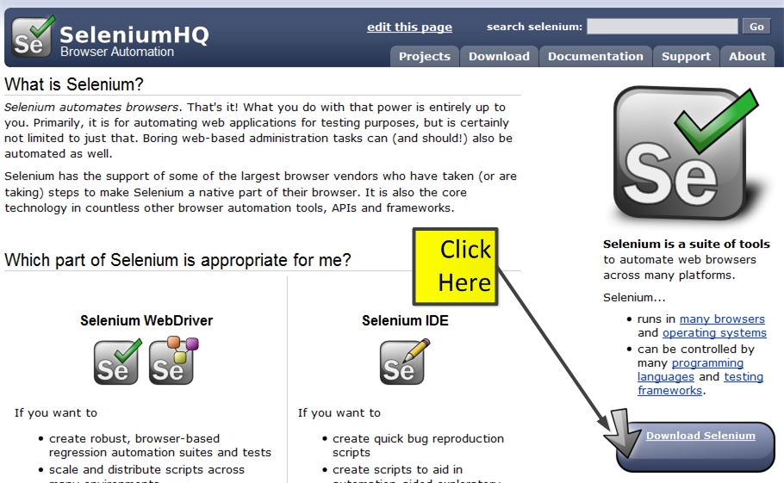
Downloading Plugin
Go to www.seleniumhq.org - click on Download

Slide 5
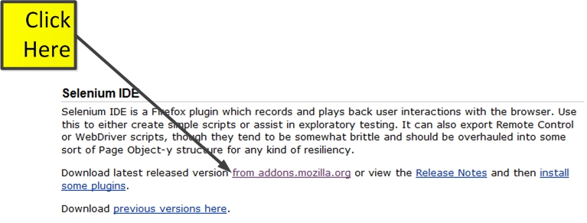
Downloading Plugin
Scroll down to Selenium IDE, per below
Click to go to mozilla add ons

Slide 6
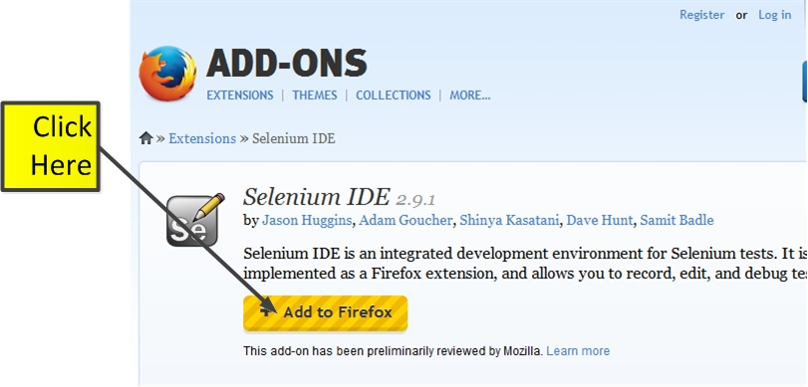
Mozilla Repository
Download, install and restart Firefox

Slide 7
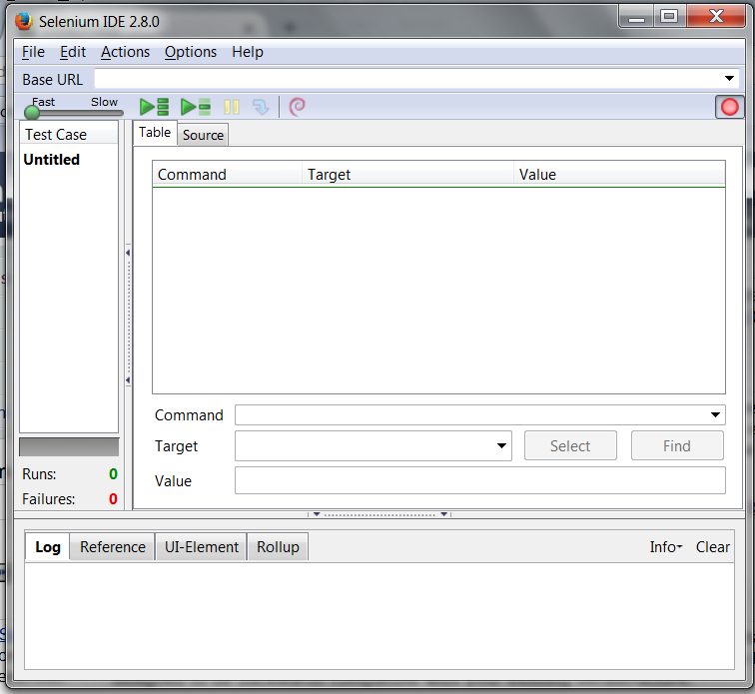
Opening the IDE
When Firefox restarts, click on Tools, Selenium IDE

Slide 8

Script Recording
Open up the web site to be tested
http://newtours.demoaut.com
Click on the Record button
Begin browsing to build your test case
After exploring one page, store the test case using a meaningful name (e.g., ‘Main’ for main page of a site, ‘Login’ for the login page…etc.
Then proceed to the next page on the site to be tested and record another script

Slide 9
Running Scripts
Select a test script
Press Run
Next, Run the same script and move the speed control

Slide 10
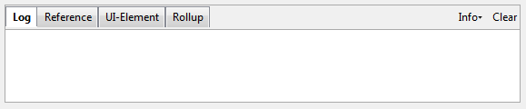
The Log
The bottom of the IDE contains a tabbed window
The log tab is used to log execution messages so you can see when a test succeeds or fails
This information is valuable for determining the cause of problems with your script
Press the Clear button to clear out old, irrelevant messages

